Slide 1

AGM 2024
Kronendal Primary School
28 November 2024

Slide 2

Agenda
Registration
Welcome & Apologies
Membership:
  Resignations
  New Members
Quorum to constitute a meeting
Previous AGM minutes
Chairman’s Report
Feedback on operations 2023/24
Approval of Annual Report 2023/24
Noting of AFS 2023/24
Approval of extension of the CID term and new Business Plan for 2025-2030, including approval of 2025/26 annual budget, surplus utilisation & implementation plan
Surplus utilisation
Appointment of a Registered Auditor
Confirmation of Company Secretary
Election of Board Members
Q & A

Slide 3
Membership/Quorum
146 members
Approximately 30% of our community
Membership list available on our website
All memberships confirmed
15 required for quorum
Acceptance of Previous Minutes

Slide 4
Chairperson’s report
Public Safety
keep our area as safe as possible/deter crime
Environmental Improvement
maintain & improve our open spaces
Urban Maintenance
working collaboratively with CCT to ensure service delivery
Social Responsibility
upliftment through relevant programmes
  Governance: manage our CID in accordance with all regulations & policies
  Communications

Slide 5
Public Safety
Strategic Plan
  Detection
  Monitoring
  Response

Slide 6
Public Safety
Managing the Deep Blue contract
  Meet monthly with Deep Blue
  Assess achievements of KPIs listed in contract
  Periodically test efficacy of response
  Evaluate upgrades to hardware

Slide 7
Public Safety
Keeping abreast of technology
  At inception 85 cameras, now 119
  LPR cameras at all vehicle entrances to SEBCID
  IR cameras replaced with thermal imaging cameras
  PTZ cameras replaced with panoramic cameras
  UPS installation for all cameras

Slide 8
Public Safety
Other activities
  Co-sponsored with HBNW the installation of solar panels, inverter and batteries at Watchcon/CCP
  Assist CCP and HBNW through monthly contributions
  Coordinate responses with CCP, HBNW and SAPS
  Make camera footage available to SAPS

Slide 9
Public Safety
Crime Stats: Hout Bay vs SEBCID

Slide 10
Public Safety
Scott Estate & Baviaanskloof Serious Incidents reported to CCP

Slide 11
Environmental Improvement
Aloe Africa maintaining our green spaces; full time 2-man team
  General gardening
  Tidying & pruning
  Collecting litter
  Removing invasives
  Clearing stormwater drains
  Unkempt verges
Approx 5 bakkie loads removed per month on average

Slide 12
Environmental Improvement for safety
Brush cutting firebreaks
  For cameras
  Access for firefighters
Cutting back on verges and public opens paces
  For cameras
  For safe vehicular passage

Slide 13
Environmental Improvement – ongoing projects
  Invasive Species management
    Increase biodiversity
    Decrease fire risk
  Felling & cutting back of dangerous trees
    Fire prevention
    Dropping limbs (at least 5x trees planted for every felled tree
  River rehabilitation
  Owl boxes

Slide 14
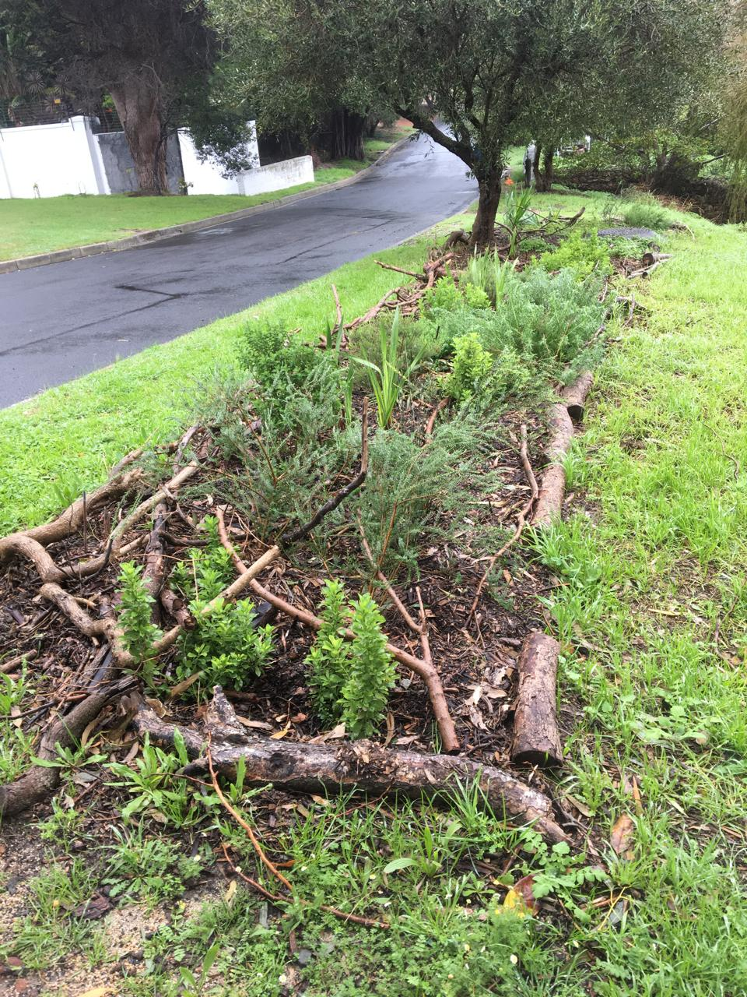
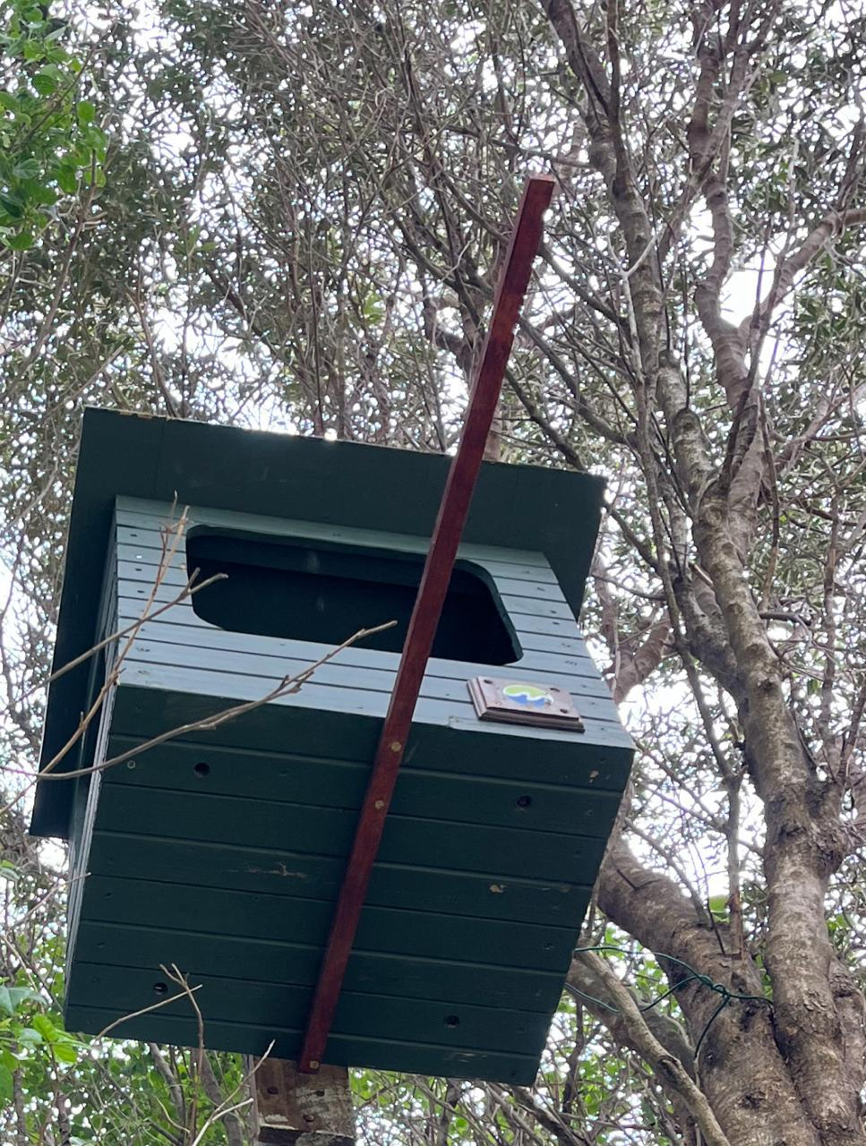
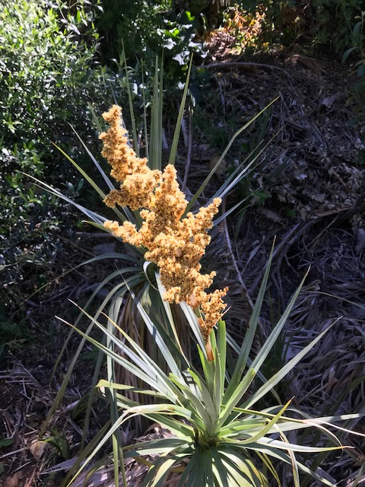
Environmental Improvement
Darling Street planting
Owl box installation
Flowering Palmiet

Slide 15
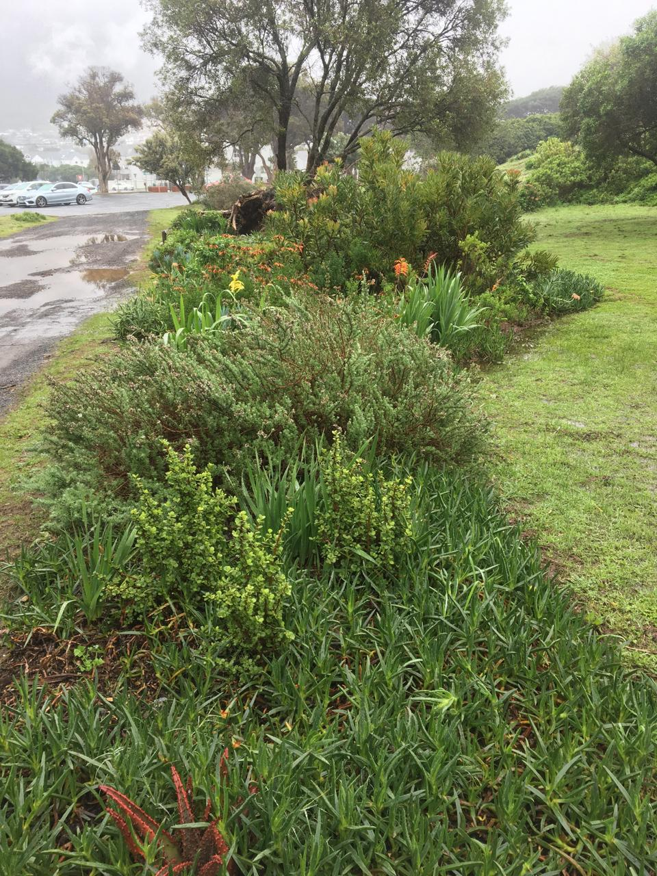
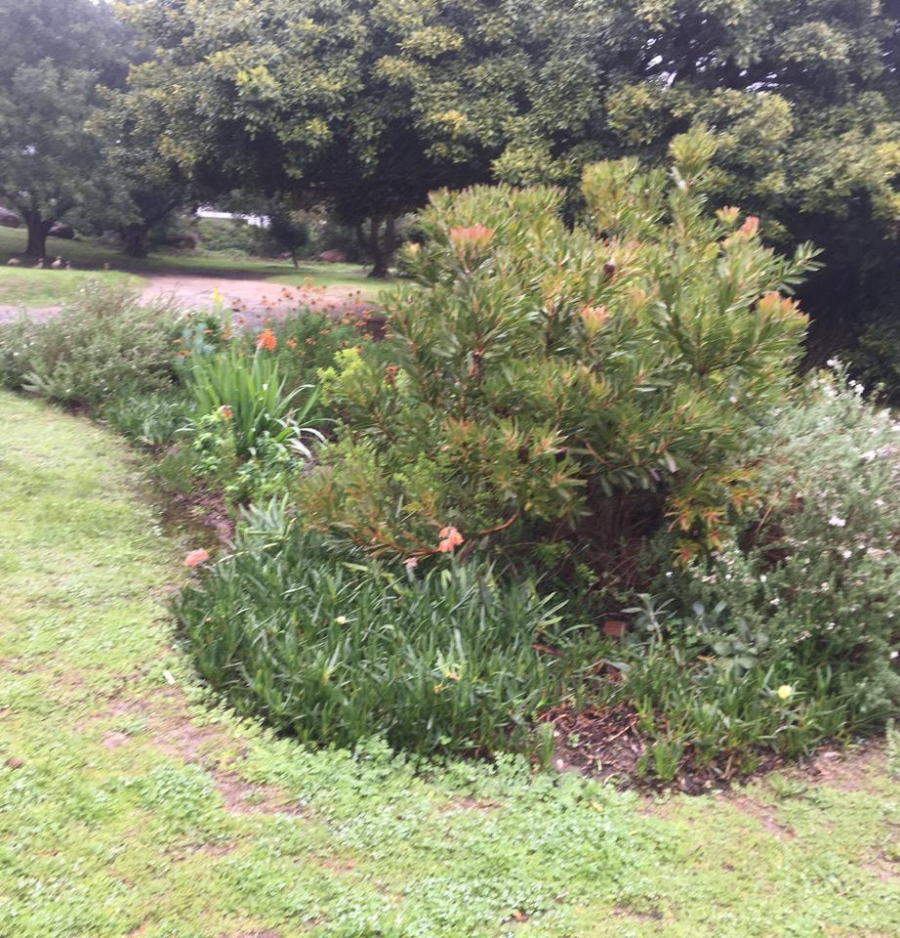
Environmental Improvement
Planting at the Scout Hall

Slide 16
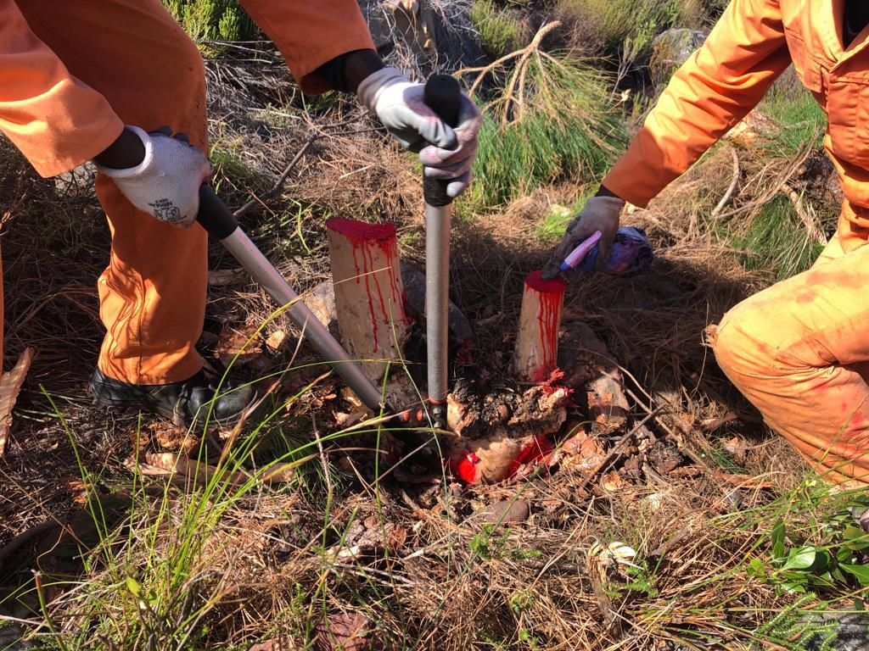
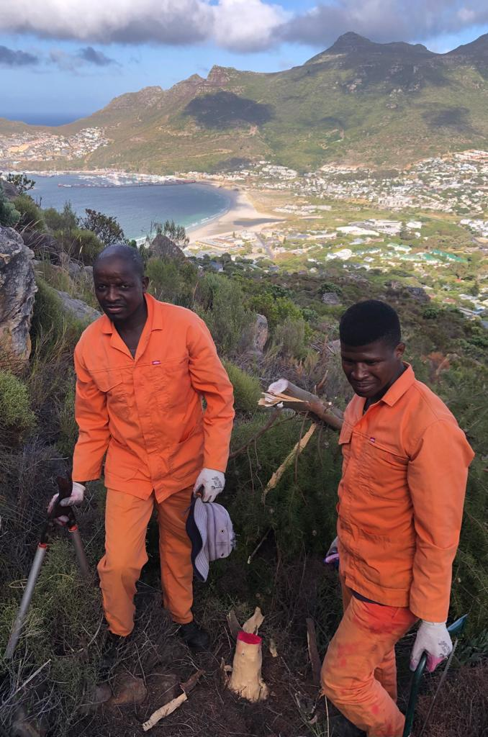
Environmental Improvement
Clearing invasive species on the mountainside above the CID

Slide 17
Urban Improvement
Hout Bay common
  Scout Hall
  Repairs to bandstand
  Maintain & repair park equipment
  Repairs to paved areas
Pathways & step off points
Follow up on C3 requests with CCT
Installation of and repairs to traffic roadside mirrors

Slide 18
Proposed Community Day Clinic

Slide 19
Social Responsibility
Hout Bay Volunteer Emergency Medical Service (HBVEMS)
First Aid Training Courses
Hout Bay Museum Hall Revamp phase 2
Reading programme at Denis Goldberg House of Hope
Bright Start Education Support Programme
Smaller once-off donations

Slide 20
Communications
Regular newsletters
Dedicated WhatsApp groups
Facebook page
Website regularly updated
  Comprehensive information resource
  Useful contacts page

Slide 21
Finance
Audited Financial Statements 2023-24 published on website
Headline figures
Core business
Surplus analysis
Potential surplus usage
2nd 5 Year Term

Slide 22
Financial 2023/24:
Headline numbers

Slide 23
Year to June 30 2024 | Budget | Actual | Variance (R) | Variance (%)
Income post 3% bad debt retention | R3069543 | R3069543
Core business expenditure | R2820750 | R2757514 | -R63236 | -2.2%
General expenditure | R275428 | R244475 | -R30953 | -11%
Projects (see detail below) |  | R1030278
Total Expenditure |  | R4032267
Interest income |  | R139830
Projects
Removal alien trees/firebreak | R303100 | R271350
Fence | R38500 | R33850
Hout Bay Common | R220000 | R50733
River Rehabilitation | R296200 | R217721
Museum Hall Refurbishment | R60200 | R57471
Battery Backup | R282205 | R282201
Legal Services | R26000 | R25952
Social – HBVEMS | R91000 | R91000

Slide 24
Additional surplus funds approved by board 2023/24
Projects | Surplus funds utilisation approved at 2023 AGM | Additional surplus funds approved by Board | Total surplus utilisation 2023/2024
Removal Alien Trees/Firebreak |  | R303100 | R303100
River Rehabilitation |  | R296200 | R296200
Social – Museum Hall Repair |  | R60200 | R60200
CCP Donation – Battery backup |  | R282205 | R282205
Hout Bay Common Project |  | R220000 | R220000
Social – HBVEMS |  | R91000 | R91000
Fence Project |  | R38500 | R38500
Legal Services |  | R26000 | R26000
Total |  | R1317205 | R1317205

Slide 25
Financials 2023/24: core business
Year to June 30 2024 | Budget | Actual | Variance (R) | Variance (%) | Comment
Cleansing services | R231000 | R230303 | -R697 | -0.3%
Environmental Improvement | R186000 | R131352 | -R54648 | -29%
Public Safety | R2241250 | R2241235 | -R15 | -
Social Upliftment | R148000 | R140150 | -R7850 | -5.3%
Urban Maintenance | R14500 | R14474 | -R26 | -0.2%
Core business | R2820750 | R2757514 | -R63236 | -2.2%

Slide 26
Current surplus
Statement of financial position
Cash reserves as at 30 June 2024 |  | R1430850
Less trade and other payables and revisions |  | -R77199
Cash available from previous financial year |  | R1353651
Plus retention fund payable Sept 2024 (incl VAT) |  | R252545
Cash available as at 30 Sept 2024 |  | R1606196
Less committed surplus funded projects in the current financial year 2024/2025 |  | -R279496
Hout Bay Common (roll over) | R169267
Alien tree removal (roll over) | R31750
River rehabilitation (roll over) | R78479
Civil Unrest provision |  | -R150000
Less 2 months of funding as provision against cash flow risk |  | -R632453
Uncommitted cash |  | R544247

Slide 27
Planned surplus funds utilisation 2024/25
Projects | Surplus funds utilization approved at 2024 AGM | Additional surplus funds approved by Board | Total surplus utilization 2024/2025
CCP Additional Donation |  | R30000 | R309496
Water Bowser |  | R26800 | R336296
Fire Break Clearing Jan/Feb25 |  | R30000 | R366296
Radio Link DB to CCP |  | R20000 | R386296
Total |  | R106800
Uncommitted Cash |  |  | R437447

Slide 28
FY 2025-2030 Proposed budget
 | FY2025/26 | FY2026/27 | FY2027/28 | FY2028/29 | FY2029/30
Income | R3707976 | R3967535 | R4245262 | R4542430 | R4860400
Core business | R3200000 | R3440000 | R3698000 | R3975350 | R4273501
Repairs & Maintenance | R15000 | R16125 | R17334 | R18634 | R20032
General expenditure | R293500 | R315512 | R339175 | R364614 | R391960
Projects | R88237 | R76872 | R63394 | R47558 | R29095
Bad debt provision | R111239 | R119026 | R127358 | R136273 | R145812
% Increase | 9% | 7% | 7% | 7% | 7%

Slide 29
Proposed budget 2025/26
Yr to June | As per business plan | Proposed | Variance
Income |  | R3707976
Core business |  | R3200000
Repairs & Maintenance |  | R15000
General expenditure |  | R293500
Projects |  | R88237
Bad debt provision |  | R111239
Total Expenditure |  | R3707976

Slide 30
Proposed budget 2025/26: core business
 | As per business plan | Proposed | % of total | Variance
Cleansing services |  | R265000 | 8.3%
Environmental upgrading |  | R240000 | 7.5%
Public safety - general |  | R2450000 | 76.5%
Public safety - CCTV monitoring
Public safety - camera leasing
Social upliftment |  | R215000 | 6.7%
Urban maintenance |  | R30000 | 0.9%
Total core business |  | R3200000
*variance vs total of all three previous line items

Slide 31
Voting
Approval of 2023 AGM minutes
Approval of 2023/24 Annual Report
Approval of extension of CID term and new Business Plan for 2025- 2030, including approval of 2025/26 budget, surplus utilisation and Implementation Plan
Reappointment of registered auditors (Harry Curtis & Co)
Reappointment of company secretary (Alison Louw)
Election of Board Members (Doreen Malan, Peter Labouchere)

Slide 32
Thank you

Slide 33
?
QUESTIONS

